Slide 1
IBM University Engagement Project Submission
“Exploring the Power of Agentic AI with IBM Granite and IBM Bob”

Slide 2

Project Tile – LearnMate AI: Personalized Course Pathways using Agentic AI
Domain of Project – Education
Student Name | Recent Passport Photo | Email ID | Mobile number [WhatsApp]
S Mahendra Selvan |  | AICTE Mail ID : smahe0719@gmail.com IBM Skills Build E-mail ID : mahendraselvan.2906@gmail.com | 8105210730
AICTE Student ID: STU6a6b5a41b31c41785420353

Slide 3
Problem Statement -
Problem Statement : LearnMate AI
The Challenge
Students often follow generic learning paths that do not consider their existing skills, interests, career goals, or learning pace. They may struggle to identify skill gaps, choose the right courses, and decide what to learn next. As their progress and preferences change, static course plans fail to adapt, leading to confusion, inefficient learning, and poor career alignment.
The Objective
Build an AI-powered Personalized Course Pathway Agent that understands each student's background and continuously creates and adapts their learning journey. The solution should:
Student Skill Assessment – Analyze current skills, education level, interests, career goals, and skill level.
Skill Gap Detection – Identify missing or weak skills required to achieve the student's target career.
Personalized Roadmap – Generate a structured learning pathway with courses, topics, resources, and recommended timelines.
Adaptive Learning Path – Dynamically modify the roadmap based on student progress, difficulties, and changing preferences.
Progress Tracking – Track completed topics, current learning phase, remaining topics, and overall progress.
AI Mentor – Provide contextual guidance, study suggestions, explanations, and motivation based on the student's roadmap and progress.

Slide 4
Proposed Solution -
Proposed Solution: LearnMate AI
LearnMate AI is an AI-powered personalized learning platform built using IBM Bob, IBM watsonx.ai, and Granite 4 H Small. It analyzes a student's skills, interests, career goal, skill level, and available study time to create an adaptive learning pathway.
Key Intelligent Components:
🧠 Skill Analysis Agent – Analyzes student profile and identifies current strengths and skill gaps.
🗺️ Personalized Roadmap Agent – Generates customized learning phases, topics, resources, and timelines.
🔄 Adaptive Learning Agent – Adjusts the roadmap based on progress, difficulties, and changing preferences.
🤖 AI Mentor Agent – Provides contextual explanations, study guidance, recommendations, and motivation.
📊 Progress Dashboard – Tracks completed topics, phase progress, skill development, remaining topics, and learning goals.
Technology Stack: IBM Bob → React + Vite → Node.js/Express → IBM watsonx.ai → Granite 4 H Small

Slide 5
Technology Used
• IBM Bob – For designing and building the core AI-powered application workflow
• IBM Granite 4 H Small – For skill analysis, skill-gap detection, personalized roadmap generation, adaptive recommendations, and AI Mentor
• IBM watsonx.ai – For accessing and running the Granite foundation model
• IBM Cloud – For providing the cloud infrastructure for the AI application and watsonx services
• React + Vite – For developing the modern, responsive LearnMate AI frontend
• Node.js + Express.js – For backend services and secure communication with IBM watsonx.ai
• REST APIs – For connecting the frontend with AI functions such as /analyze, /roadmap, /adaptive, and /mentor
• Context-Based Personalization – Uses student profile, skill gaps, roadmap, and progress to provide personalized AI recommendations

Slide 6
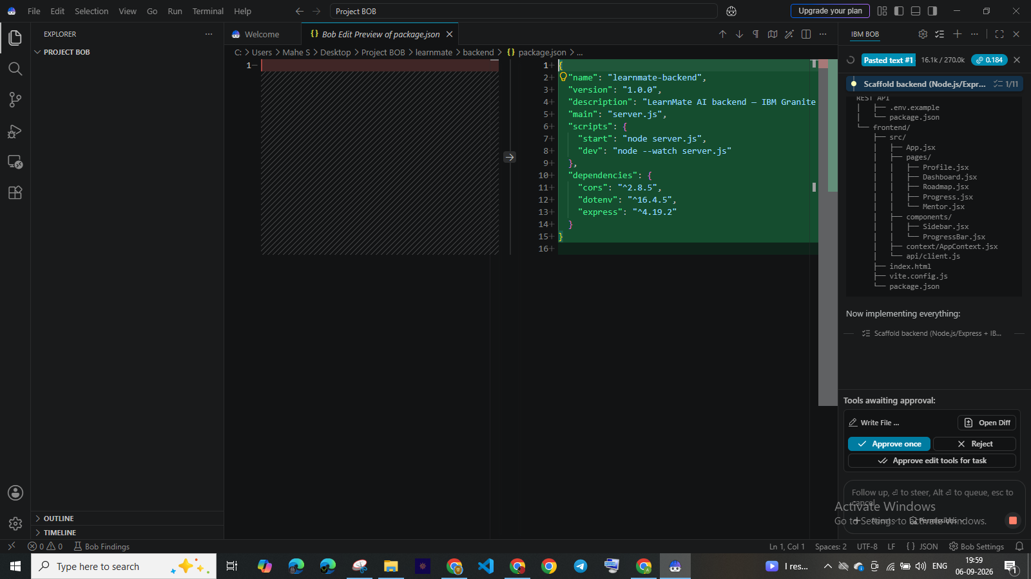
Required Files created using IBM bob -

Slide 7
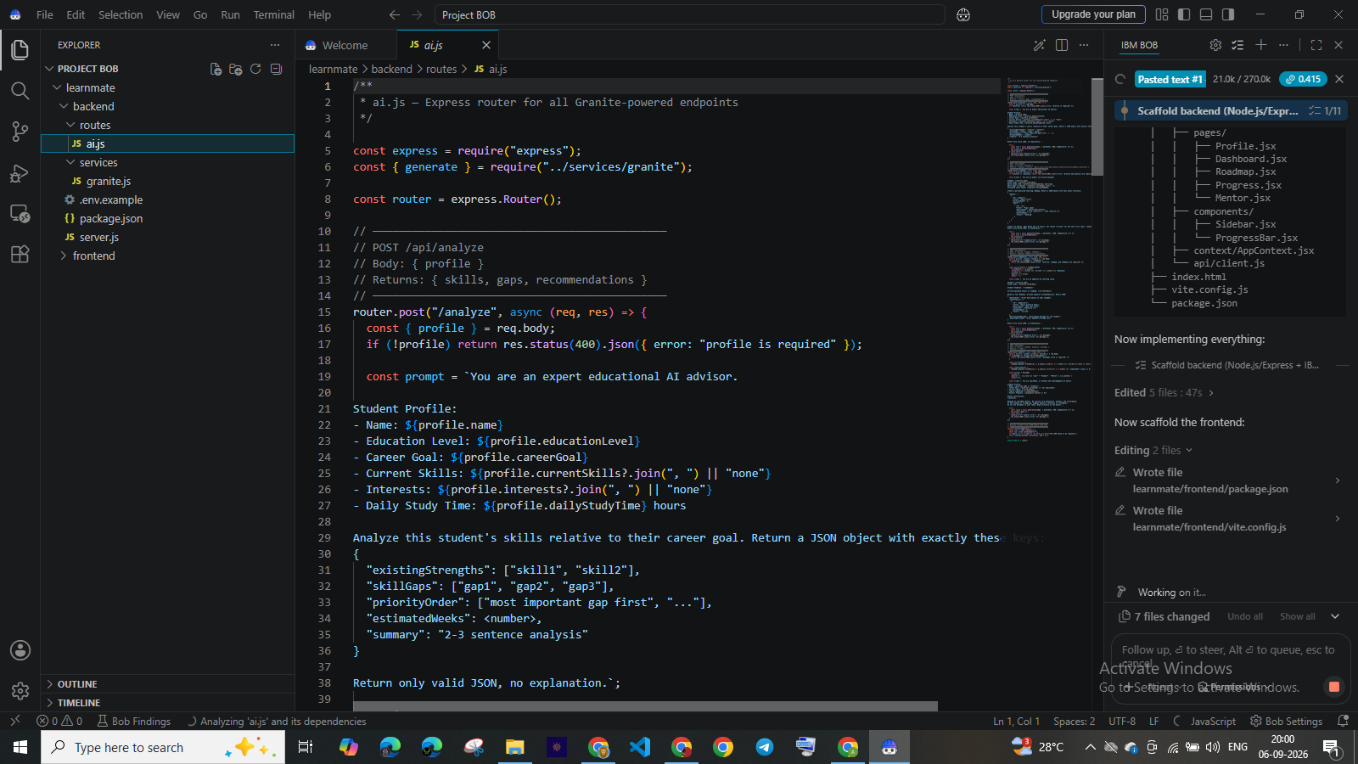
IBM Bob Screenshots:

Slide 8
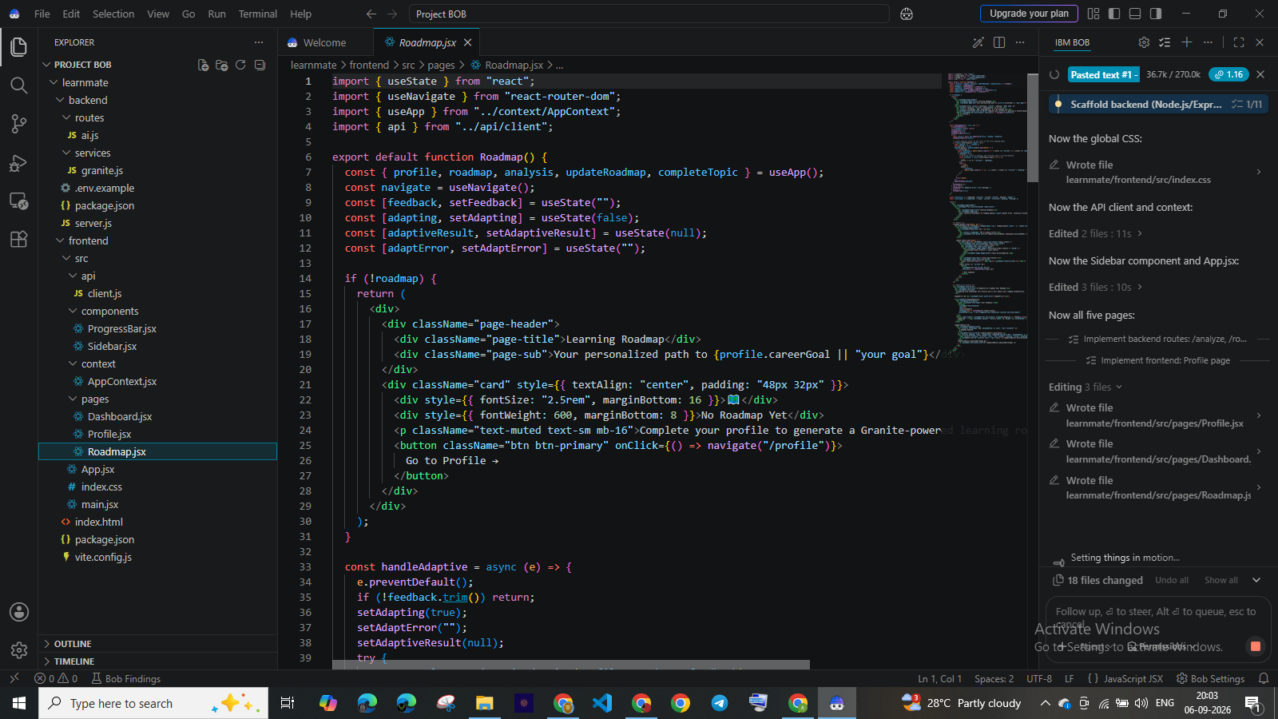

Slide 9
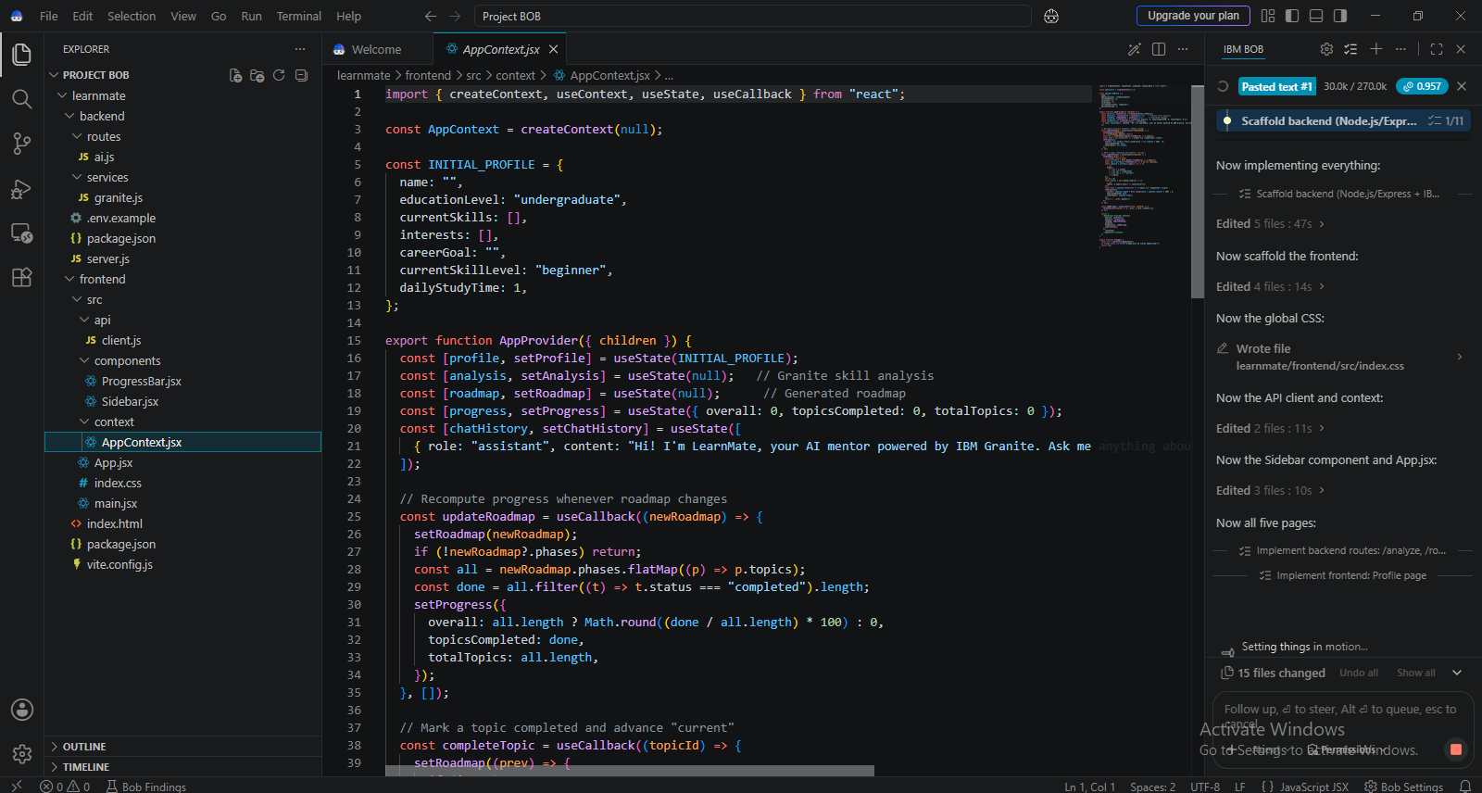

Slide 10
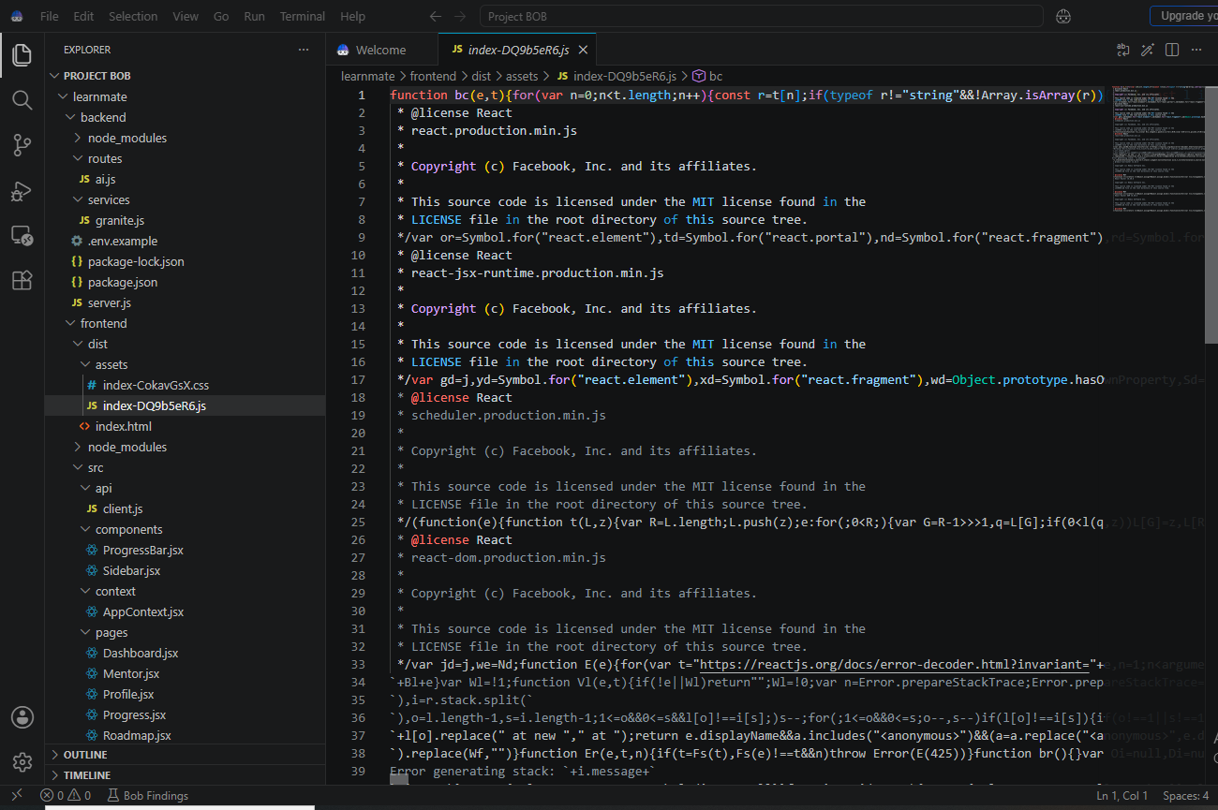

Slide 11
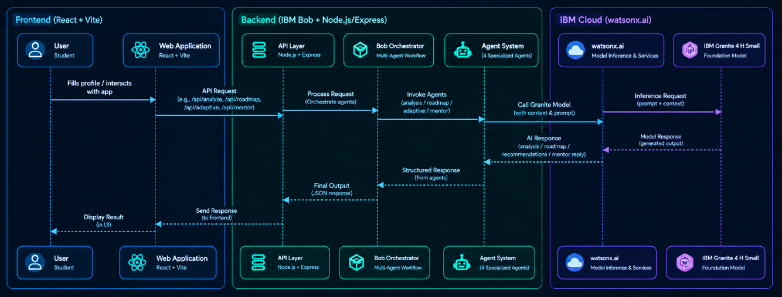
Architecture blueprint for IBM bob:

Slide 12

Role of Agentic AI in the solution
Agentic AI enables LearnMate AI to operate as an intelligent, goal-oriented learning system rather than a simple chatbot.
• Autonomous Task Execution – Performs skill analysis, gap detection, roadmap generation, adaptation, and mentoring.
• Context Awareness – Uses student skills, interests, career goals, skill level, study time, and progress to personalize decisions.
• Dynamic Adaptation – Adjusts learning recommendations when students struggle or their learning needs change.
• Goal-Driven Planning – Continuously aligns the learning pathway with the student's target career.
• Progress-Based Decisions – Uses completed topics and current progress to determine what the student should learn next.
• AI Mentor – Provides contextual guidance, explanations, study suggestions, and motivation.

Slide 13
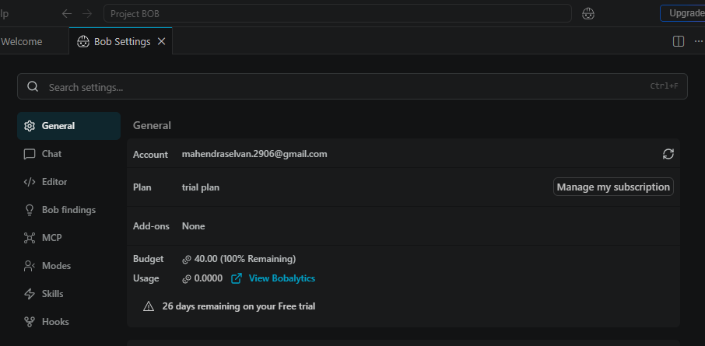
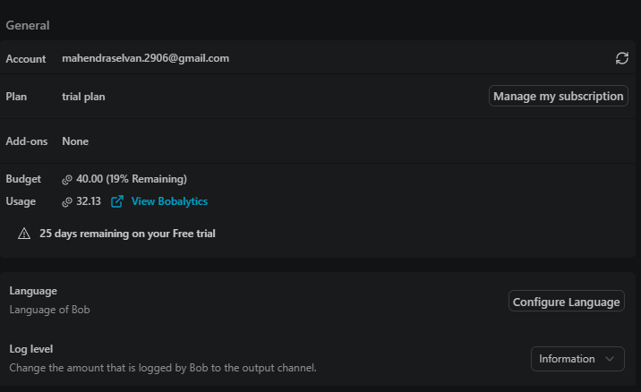
Token Usage
Before Prompt
After the Prompt
·
·
·

Slide 14
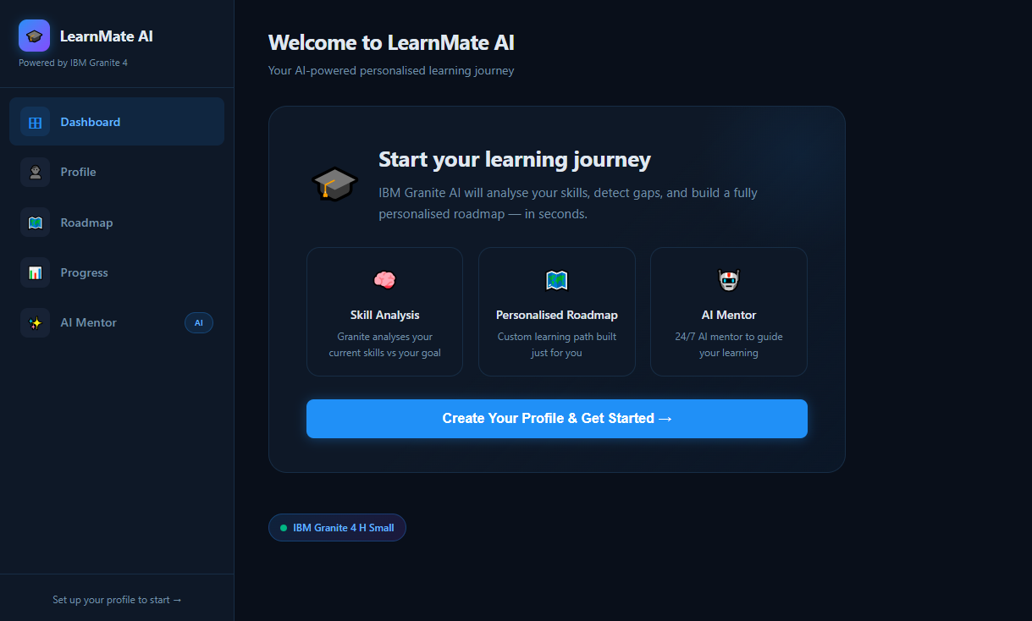
Project Output Screenshot
·
·
·

Slide 15
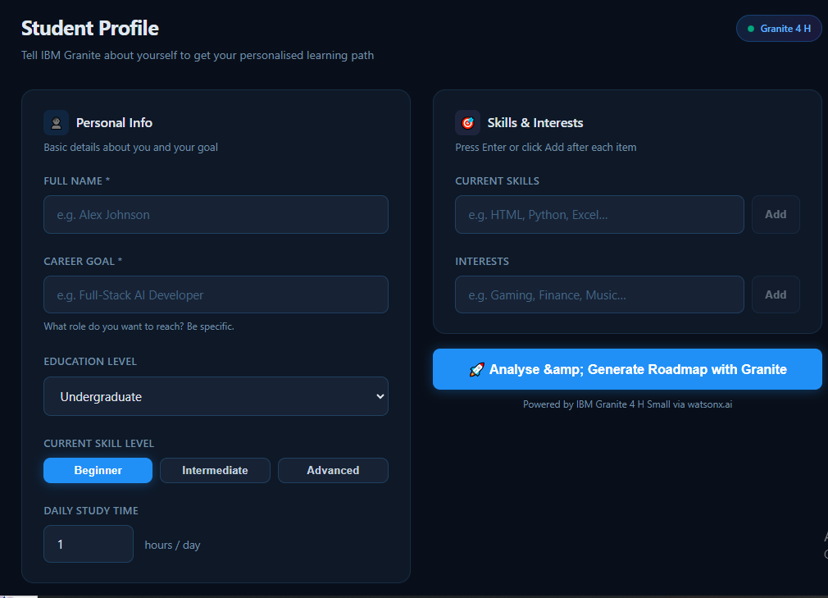
Project Output Screenshot
·
·
·

Slide 16
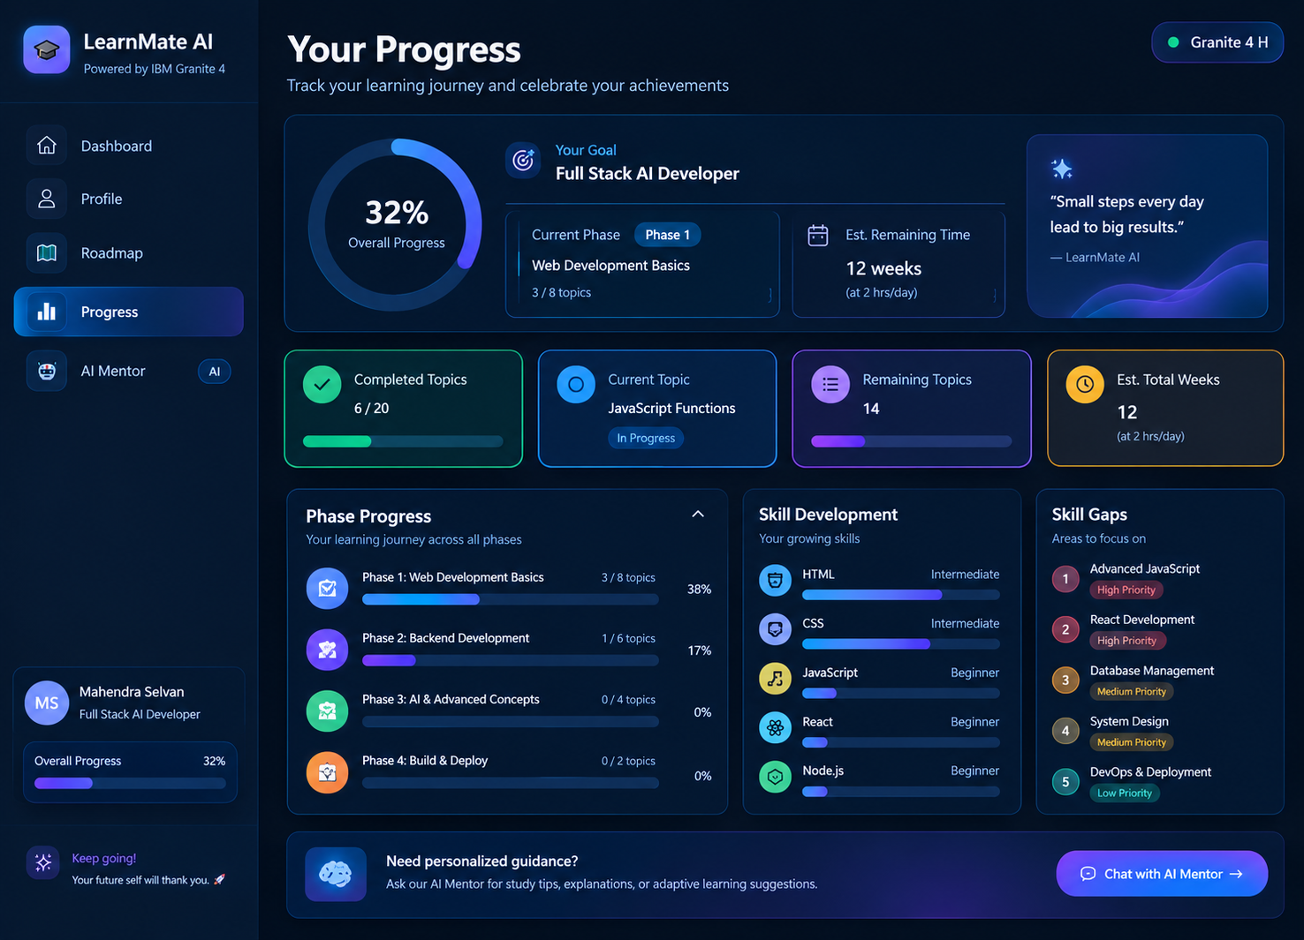
Project Output Screenshot
Please put IBM Bob output screenshots with 2-3 prompts.
You can take 2-3 more slides for each screenshot
·
·
·

Slide 17
Novelty and Uniqueness
Agentic Intelligence – Uses goal-oriented AI to perform skill analysis, planning, roadmap generation, adaptation, and mentoring.
Dynamic Roadmaps – Creates personalized learning paths that align with the student's existing skills and desired career goal.
Hyper-Personalization – Considers the student's skills, interests, skill level, available study time, and learning progress.
Real-Time Adaptation – Adjusts learning recommendations when students face difficulties or provide new feedback.
Progress-Driven Learning Loop – Continuously connects assessment → roadmap → learning → progress → feedback → adaptation.
Contextual AI Mentor – Provides personalized study guidance, explanations, recommendations, and motivation based on the student's learning journey.
Career-Oriented Learning – Connects individual learning activities and required skills with the student's target career.
IBM Granite 4 H Small – Uses IBM Granite through watsonx.ai to power intelligent skill analysis, personalization, roadmap generation, and recommendations.

Slide 18
Git Hub Link
https://github.com/MS2906/Mahendra-Selvan-_Learnermate_IBM
·
·
·

Slide 19
Future Scope
1. Integration with Learning Platforms & Course Libraries – The system can be integrated with platforms such as online course providers, educational repositories, and institutional LMS systems to automatically recommend relevant courses, tutorials, assignments, and learning resources based on the student's skill gaps and career goals.
2. Multilingual & Voice-Based AI Mentor – Future versions can introduce voice interaction and multilingual support, allowing students to communicate with the AI Mentor in their preferred language. This can improve accessibility and make personalized learning more inclusive.
3. Advanced Progress & Performance Analytics – The platform can analyze learning speed, topic completion, assessment performance, and recurring difficulties to provide deeper insights and make roadmap adaptation more accurate.
4. Automated Skill Assessment & Quizzes – LearnMate can generate AI-powered quizzes, coding challenges, and assessments based on the student's current level and use the results to automatically update their skill profile and roadmap.
5. Career & Job Market Integration – The system can integrate real-time industry skill trends and job requirements to identify emerging skills and continuously align personalized learning paths with changing career opportunities.
·
·
·

Slide 20
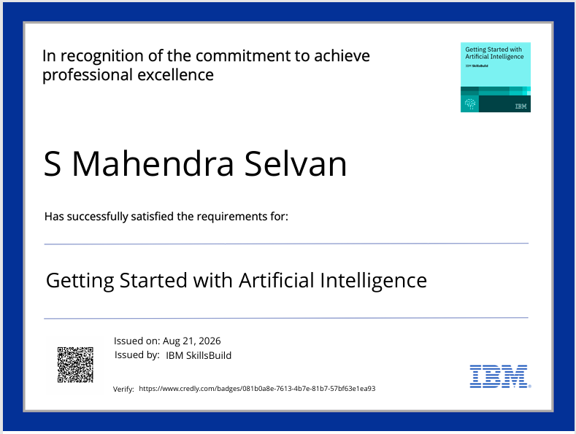
Certificates Earned:
Please add your credly certificate(Getting Started with Artificial Intelligence)

Slide 21
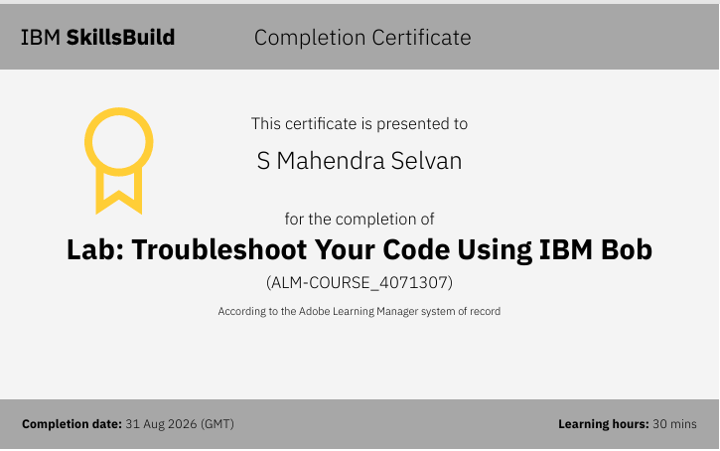
Certificates Earned:​
Add your IBM BOB Certificate

Slide 22


